Slide 1

Predicting the
With NLP and Machine Learning
Josh “Married Josh” F
ITC Personal Challenge
Summer DS Fellows ‘18

Slide 2
"Analyzing humor is like dissecting a frog. Few people are interested and the frog dies of it."
Notes:
old quote vs actual quote - EB White was famous NYer humourist

Slide 3
“Humor can be dissected, as a frog can, but the thing dies in the process and the innards are discouraging to any but the pure scientific mind.”
Notes:
old quote vs actual quote - EB White was famous NYer humourist

Slide 4
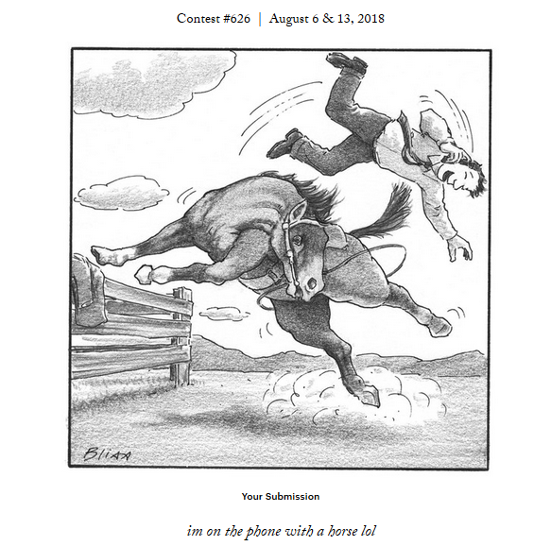
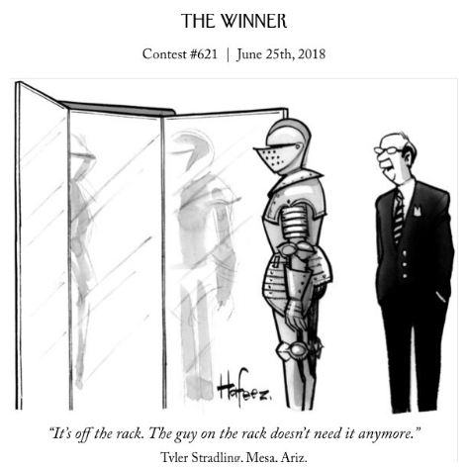
<
?
Notes:
I try my hardest to come up with the funniest quote for this picture

Slide 5
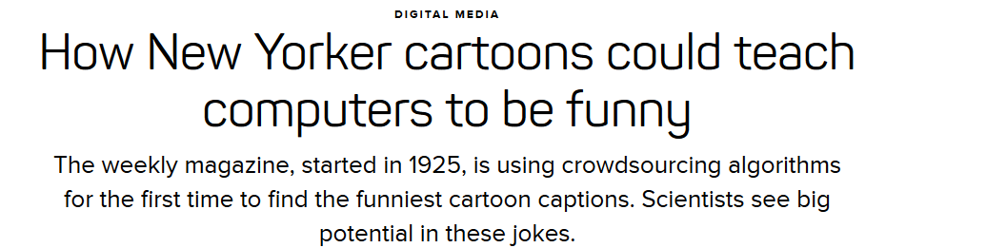
DATA SET
Notes:
(link)

Slide 6
THE CHALLENGE
~26,000,000 rated captions
Two forms - dueling bandits, or choose 1 of 3 ratings
Shahaf et al. (2015) did similar idea on dueling bandits, I used reward func
Extract features and test various ML algorithms
Metric: Mean Squared Error
Find features which most correlate with higher score
Predict what makes a winning caption!

Slide 7
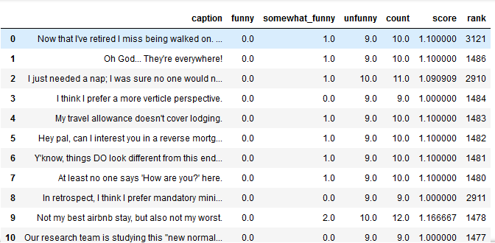

Slide 8
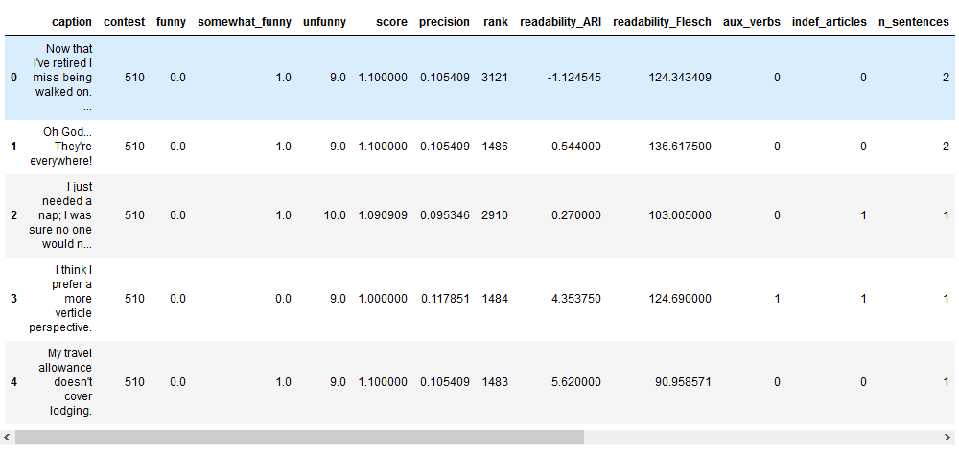

Slide 9
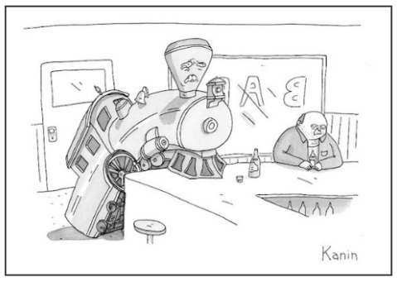

Slide 10
CAPTIONS
No one wants to hire a whistleblower.
I just feel there's no light at the end of the tunnel.
We uncoupled.
Sometimes you only think you can.
Just one more until I think I can.
No one cares about MY baggage.
You think *your* life is a train wreck?
She says I travel too much.
Notes:
Git LFS was learning curve

Slide 11
DATA SET
Updated regularly on GitHub (I downloaded ~1 month ago, but still going)
Files stored using Git LFS (Large File System)
Distributed over several hundred csv files
Glob files, extract relevant features, calculate linguistic features, save to csv
Notes:
Deployed by NextML, a consultancy, and developed by Kevin Jamieson, during PhD at U. Wisconsin
Git LFS was learning curve

Slide 12
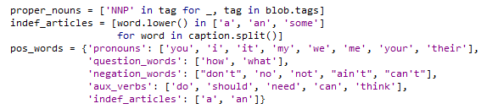
Methodology

Slide 13


METHODOLOGY
Feature extraction: sentence length, avg word length, 2 readability scores, word types, sentiment
Rebalanced score:
Jamieson used 3 * F + 2 * S_F + 1
I used 1 * F + 0.5 * S_F + 0 * N_F
Unbalanced data ---> downsampling
Alternative: bin by quantile/value ---> classification problem
Looking at words over time
Notes:
Not sure why Jamieson did the way he did

Slide 14
METHODOLOGY (cont.)
NLP libraries: Textblob -> NLTK -> SpaCy
Custom stopwords and punctuation, choose stemmer vs SpaCy out of the box
Getting meaningful vocabulary/collocations per image
Another approach: isolating ‘factoids’, named entities, proper nouns - naive approach vs King et al. (2013) - clustering words by similarity, collocation of feature vectors (cosine distance)

Slide 15
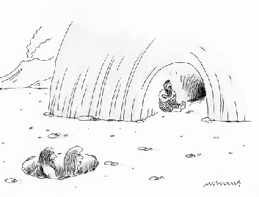
He got the cave but she got the wheel and the fire.
So this is how the 1% live.
I couldn't afford that place if I lived to be 30.
He got the man cave in the divorce.

Slide 16
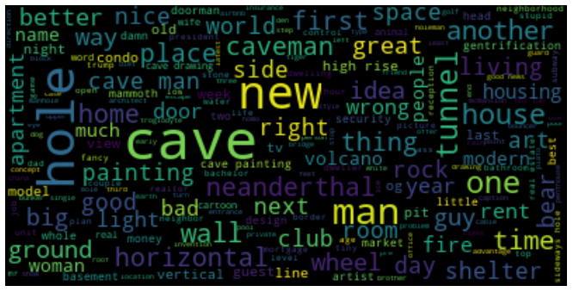

Slide 17
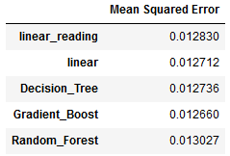
RESULTS
Best result is from XGBoost - beats Random Forest, simple Linear Regression: 0.010474 MSE
σ of base sample = 0.459709
Best factors:
Proper nouns
Chars in caption
Readability (A.R.I.)
Indefinite articles
Notes:
Results before downsampling were substantially better

Slide 18
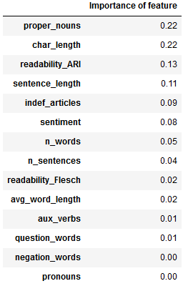
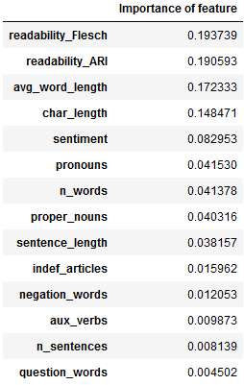
XGBoost Random Forest

Slide 19
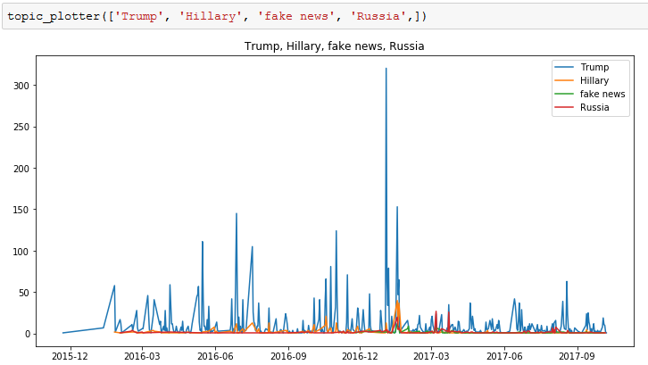
RESULTS
Notes:
Talk about finding named entities - SpaCy, news APIs, match and add to score

Slide 20
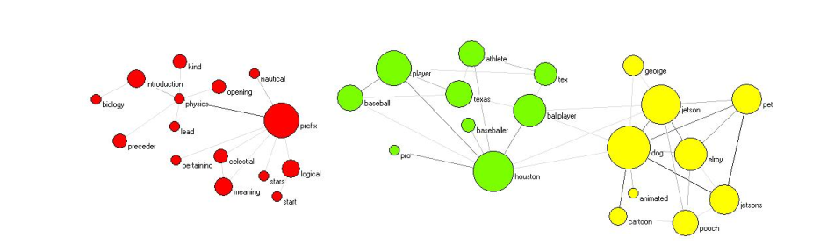
$cat TODO.txt
>correlate with news topics
>spellcheck
>words -> features, PCA
>word2vec

Slide 21
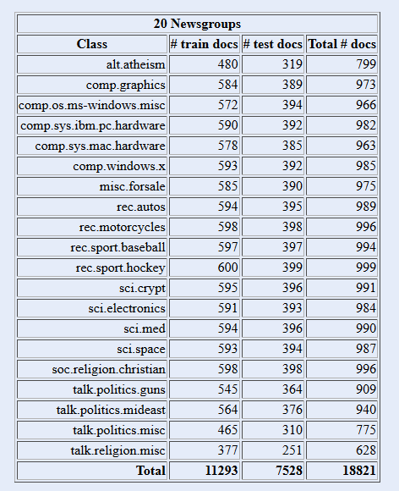
BONUS MATERIAL!
Classifying headlines as “technical” or “non-technical”
No labelled data - using external data source
Lessons: ML is domain-specific
GIGO

Slide 22
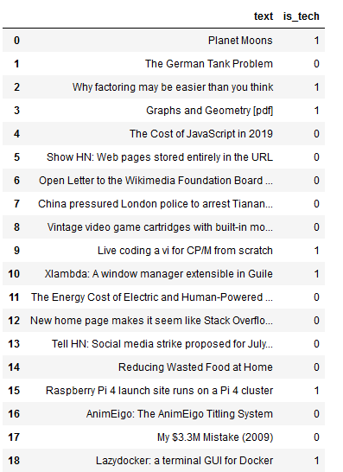
RESULTS
(better than random?)

Slide 23
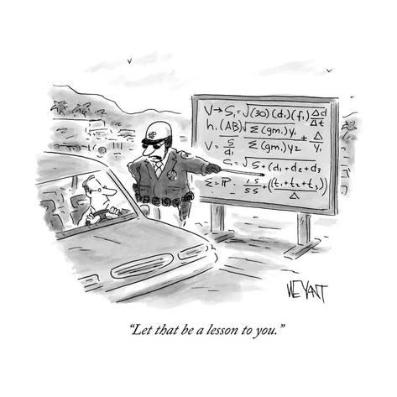
THE END
Notes:
Hope you learned something!

